Slide 1
‘Wireless Prepaid Energy Meter using GSM’
Team Members:
Rucha Ghare(roll no-58,sec-B)
Sampada Nande(roll no-59,sec-B)
Sanskruti Bhujade(roll no-60,sec-B)
Guide:
Dr.Mridula Korde
Session 2022-23
Department of Electronics & Communication Engg.

Slide 2
Problem Statement/objectives
Project Objectives:
To create a wireless energy meter using gsm module

Slide 3
Existing Solutions
Several existing solutions and technologies in the market are addressed with similar objectives as our project. These solutions offer various features and functionalities to monitor and control energy consumption.
Smart Energy Meters: Smart energy meters are advanced digital devices that monitor and record energy usage in real-time. They provide detailed information on energy consumption, allowing users to track and analyze their usage patterns.
Prepaid Energy Systems: Many utility companies and service providers offer prepaid energy systems, similar to prepaid mobile phone plans. Users can purchase energy credits in advance and consume electricity until the credit is depleted. These systems typically involve the use of prepaid cards or online payment portals to recharge the energy credit. The users can monitor their energy balance and receive notifications when the credit is low.
Home Energy Management Systems: Home energy management systems integrate multiple components and technologies to optimize energy usage. These systems may include smart thermostats, energy monitoring devices, and automation controls.

Slide 4
Literature Survey
1. "Design and Implementation of a GSM-Based Prepaid Energy Meter" by K. A. Alese, M. O. Popoola, and A. O. Awoseyila: This paper presents a design and implementation of a GSM-based prepaid energy meter system. It focuses on the integration of GSM technology to enable remote monitoring and control of energy consumption, as well as prepaid billing functionality.
2. "Development of Prepaid Energy Meter Using GSM Network" by R. S. Hegde, A. S. Hegde, and A. J. Khandolkar: This research work proposes a prepaid energy meter system that utilizes GSM network communication for data transfer between the meter and the service provider. It describes the architecture, implementation, and testing of the system.
3. "Design and Development of a Prepaid Energy Metering System Using GSM Technology" by M. O. Ibrahim, A. A. Yusuf, and B. O. Are: This study presents the design and development of a prepaid energy metering system based on GSM technology. It covers the hardware and software aspects of the system, including the integration of the GSM module for communication and the implementation of prepaid billing.

Slide 5
Proposed solution
By sending a simple SMS, we can recharge the electricity balance through this system. It can also disconnect the home power supply connection if there is a low or zero balance in the system. The Anti-Theft Alert can also be detected when someone tries stealing the meter by opening the lid.
Integrating the use of a mobile application as the primary interface. Allows users to access detailed energy consumption data, set energy-saving preferences, receive real-time alerts, and interact with the system more intuitively.
Incorporating smart grid technology into the prepaid energy meter system. This allows for two-way communication between the energy meter and the utility provider, enabling real-time monitoring, data exchange, and remote management of energy consumption. It provides more accurate billing, better load management, and the ability to respond to demand fluctuations effectively.

Slide 6
The Analog Electricity Energy Meter input terminal connects to 220V AC Power Supply. Its output terminal connects to the output of the single-channel Relay Module.
The 16×2 LCD Display connects to the Pins of the Arduino UNO Board. We have used SIM800 GSM Module for GMS SMS functions which is the most important part of this project. The GSM has UART Pin as Tx & Rx which connects via Software Serial to digital pins 11 and 12 of Arduino. The GSM Module requires 3.3V-4V Power Supply. So an external 9V DC power supply like DC Power Adapter can be used. Hence the GSM and Arduino both are powered via 9V DC Adapter.
The Relay, Buzzer, and Limit Switch are connected to D8, D7 & A0 of Arduino.
The Limit switch is placed at the opening of the meter door. It is used to check whether the box is opened or not and can prevent theft.
The most important thing is connecting the meter to the Arduino. At the back of the meter, there are Pulse LED or Cal LED terminals which are basically cathode and Anode.

Slide 7
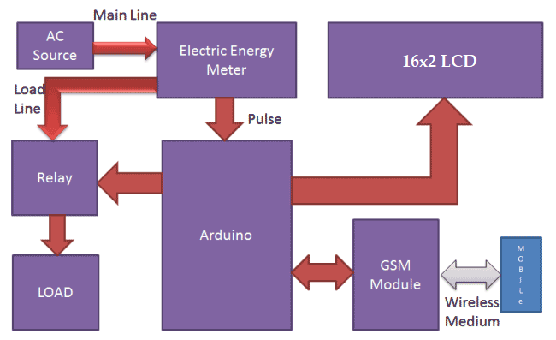
Block Diagram
The block diagram gives a brief overview on how the connections are established within the various components.Used here are: Arduino uno,16*2 LCD display,Sim800l gsm module,energy meter,load,relay module.

Slide 8
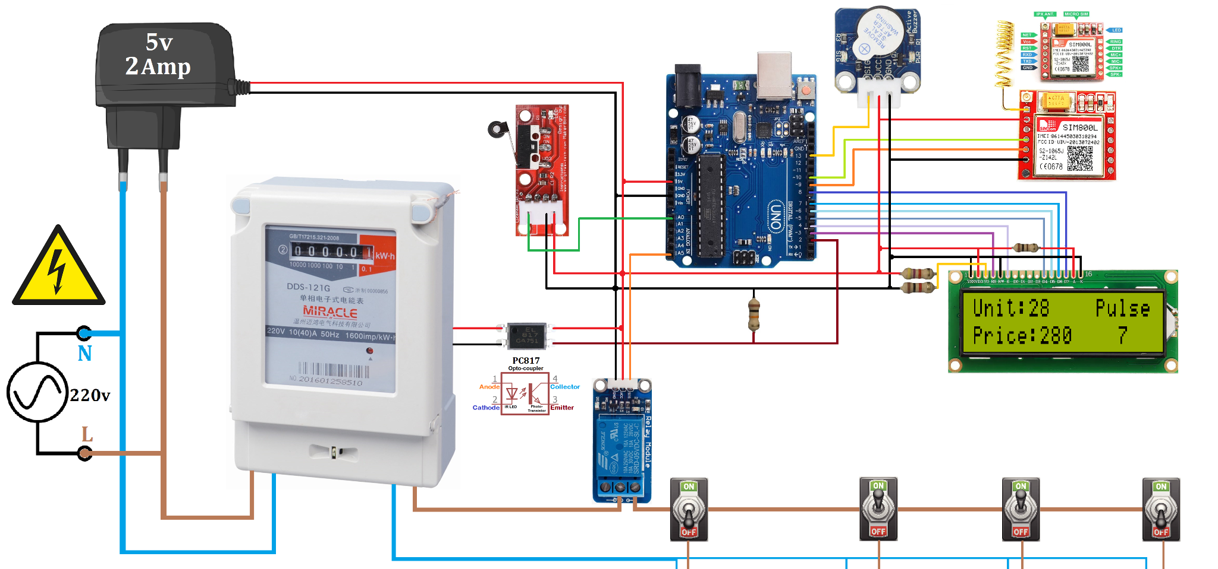
Circuit Diagram

Slide 9
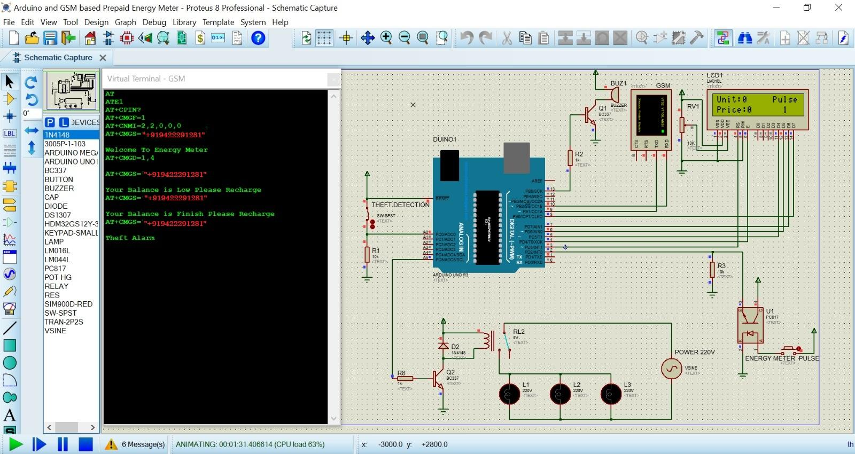
Results (Intermediate results/simulation results)

Slide 10
Feasibility Analysis
Technical Feasibility: This involves evaluating the technical aspects of implementing a wireless prepaid energy meter using GSM. It includes assessing the availability and coverage of GSM networks in the target area, compatibility of the chosen GSM module with the metering system, and the ability to establish reliable and secure communication between the meter and the service provider.
Economic Feasibility: The economic feasibility analysis involves assessing the cost of implementing and operating the wireless prepaid energy meter system. It includes evaluating the costs associated with hardware, software, GSM module integration, installation, maintenance, and support. Additionally, the analysis considers the potential cost savings and revenue generation through efficient billing and reduced manual meter reading efforts.
User Acceptance: Understanding user acceptance is crucial for the success of any system. In the case of a wireless prepaid energy meter, factors such as user convenience, ease of use, and familiarity with GSM technology should be evaluated. User feedback and acceptance testing can provide insights into the practicality and usability of the system.

Slide 11
Regulatory and Legal Considerations: It is essential to analyze the regulatory and legal requirements associated with deploying a wireless prepaid energy meter using GSM. This includes compliance with telecommunications regulations, data privacy laws, and any specific regulations related to energy metering and billing in the target region.
Scalability and Future Potential: Assessing the scalability of the system is important to determine if it can handle a large number of meters and support future expansion. Additionally, exploring the potential for future enhancements, such as integrating with smart grid infrastructure or enabling advanced analytics, can provide insights into the long-term viability and adaptability of the system.
Overall, a feasibility analysis of a wireless prepaid energy meter using GSM technology considers technical, economic, user acceptance, regulatory, and scalability factors. It helps determine if the system is technically feasible, financially viable, acceptable to users, compliant with regulations, and has potential for future growth and enhancements.

Slide 12
Innovation or Uniqueness of the solution
These days the incidents regarding theft of energy are overpowering.To help the people get them the energy they require and to stop these crimes we have added a theft alert in the project.
There is a switch placed inside the energy meter,such that when anyone tries open and cut the wire the switch will be tampered and a message from the arduino will go to the gsm module,through which a message will be generated to the provider and he will be alert.

Slide 13
Impact or Usefulness of the solution
Energy Conservation: Wireless prepaid energy meters encourage energy conservation by providing consumers with real-time information about their energy consumption. This awareness helps individuals and households to make more conscious choices about their energy usage, leading to reduced energy wastage and a more sustainable society.
Financial Empowerment: Prepaid energy meters empower consumers to have better control over their energy expenses. By allowing users to pay for electricity in advance, they can budget their energy costs more effectively and avoid unexpected high bills. This financial empowerment can have a positive impact on individuals and families, particularly those with limited financial resources.
Reduction of Energy Theft: Wireless prepaid energy meters minimize the risk of energy theft and illegal connections. Since electricity is prepaid and meters can be remotely monitored, it becomes much more difficult for individuals to tamper with or bypass the metering system. This helps ensure that energy is distributed fairly and reduces the economic burden on legitimate consumers.

Slide 14
Improved Service Delivery: Wireless prepaid energy meters enable utility companies to provide more efficient and responsive service. By remotely monitoring meters, utilities can identify and address issues such as power outages or meter malfunctions promptly. This leads to faster problem resolution and improved overall service quality for consumers.
Environmental Benefits: The promotion of energy conservation through prepaid energy meters can contribute to environmental sustainability. Reduced energy consumption means fewer greenhouse gas emissions, which helps mitigate climate change and reduces the strain on natural resources.
Overall, the introduction of wireless prepaid energy meters benefits society by promoting energy conservation, empowering consumers, reducing energy theft, improving service delivery, and contributing to environmental sustainability.

Slide 15
Summary
A wireless prepaid energy meter using GSM technology combines the features of a prepaid energy meter and GSM communication to enable remote monitoring, control, and prepaid billing for energy consumption. It utilizes GSM networks for real-time data transfer between the meter and the service provider, allowing consumers to purchase energy credits in advance and conveniently monitor their usage. The system offers cost savings, improved revenue collection, and flexibility in payment options. It also has the potential for future integration with smart grid technologies, providing a convenient, efficient, and scalable solution for energy management.

Slide 16
References
Tukur Gupta, Vaibhav Karnail, Parth Pandey, Gaurav Verma ,“GSM Based Design and Development of Smart Energy Meter Using EEPROM, LCD, and Microcontroller”
K.Bowya1,I.S.Pradeeba Levina2 ,K.Aruna,”GSM Based Smart Energy Meter”
P. Uday Kumar, K. Kavya, M. Sravani, M. Durga Prasad and Kiran Kumar Kuthadi,”GSM-Based Smart Energy Meter with Arduino Uno”

